Slide 1
Weekly Report
10/3/22
Erin Ingram & Omar Mahmood
NanoBio Systems Lab
Texas A&M University

Slide 2
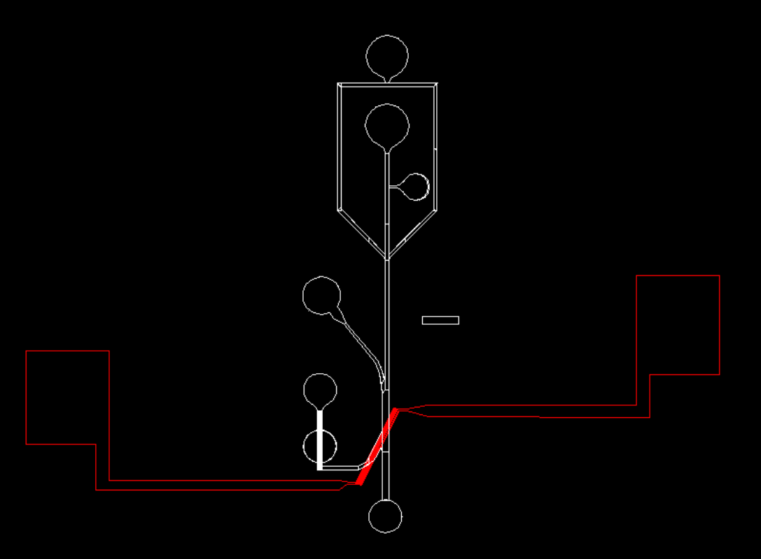
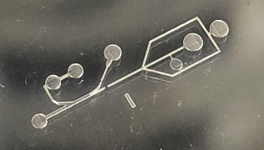
Progress
Softlithography training
Designed high pass, band pass filter channels and IDEs in AutoCAD
Printed high pass filter channel with NanoScribe in cleanroom
Investigating issue with disconnect in the master mold

Slide 3
Goals for next week
Troubleshoot problem with misprint, reprint the master mold
If printing issue resolved:
Move forward with softlithography fabrication of the high pass filter
Test droplet generation with it

Slide 4
Thank you for your time!

